Slide 1





Smart Picks: Your AI-Powered Shopping Buddy
On Development of an on-Premise AI Product Recommendation Model Using Open-Source LLM
Atique Md Monir Ahammod Bin
Department of Artificial Intelligence Convergence

Slide 2

Project Description
Project Title
Development of an on-Premise AI Product Recommendation Model Using Open-Source LLM
Company: Narosu Co. Ltd.
Project Description
The e-commerce market is becoming increasingly competitive, requiring advanced recommendation systems.
Large marketplaces use sophisticated AI models, but independent online store operators lack such solutions.
This project aims to develop an AI-powered product recommendation system tailored for self-managed online stores.
By analyzing customer preferences, the system will suggest products that align with their interests.
Project Objective
Develop an AI-based search and recommendation system that analyzes user input sentences and recommends the TOP 5 most relevant products based on semantic similarity.
Utilize Natural Language Processing (NLP) and vector search technology to provide a highly refined search experience.
Deploy in an on-premise environment to ensure data privacy and full control over the recommendation process.
1

Slide 3
Selected Technology Stack
Selected Model and Vector Store:
Component | Technology Used | Description
LLM (Large Language Model) | LLaMA 3.1 8B instant | Performs reasoning and generates responses based on user input and context
LangChain (LLM Framework) | LangChain | Connects LLMs to external tools and vector databases for enhanced reasoning and document access
Embedding Model | OpenAI text-embedding-ada-002 | Converts text into dense vector representations using semantic similarity
Vector DB / Search | Qdrant | High-dimensional vector indexing with cosine similarity, metadata filtering, and hybrid search
Vector Search Library | Qdrant (built-in) | Optimized internal search within Qdrant; no separate library like FAISS needed
RAG (Retrieval-Augmented Generation) | LangChain + Qdrant + LLM | Retrieves semantically relevant documents from Qdrant to support LLM-generated answers
API Architecture | Gradio + FastAPI | Gradio handles UI and function binding; FastAPI supports additional backend API endpoints
GUI (Graphical User Interface) | Gradio | Provides interactive chatbot interface with support for image display and recommendation output
2

Slide 4


Requirements Fulfillment Summary - ✅ 100% Fulfilled
Company Requirement Alignment
LLM Setup (LLaMA 3.1 8B Instant)
LangChain Integration
OpenAI Embedding + Vector DB (Qdrant)
Vector Search & RAG Implementation
API Development (FastAPI + Gradio)
Chatbot GUI with Image Display
Recommendation Logic (OwnerClan 3 + Naver 2)
Fallback logic for alternative recommendations
Response Time Optimization (≤ 5s)
Flexible model/embedding model architecture
Mutiple languages support
Modifiable attribute fields (title, code, origin, etc.)
️
Extra Features:
Login/ Register Option
Mutiple Users Management
Chat History Option
Voice Input
Dedicated Naver Product Search Button
Evaluation Dashboard
3

Slide 5
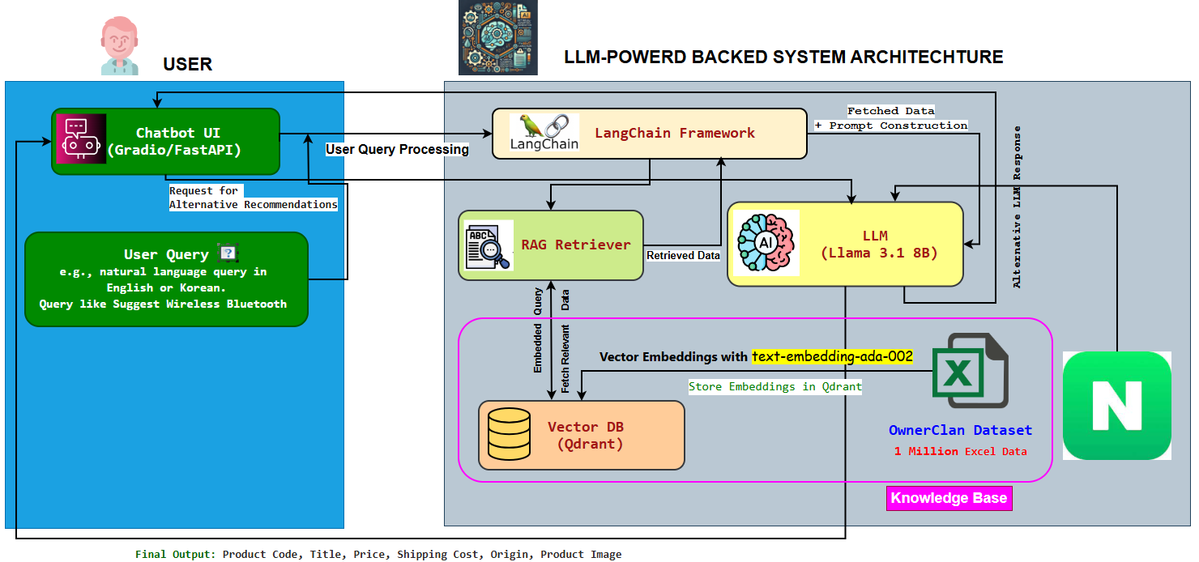
System Configuration (AI Model) Diagram
4

Slide 6
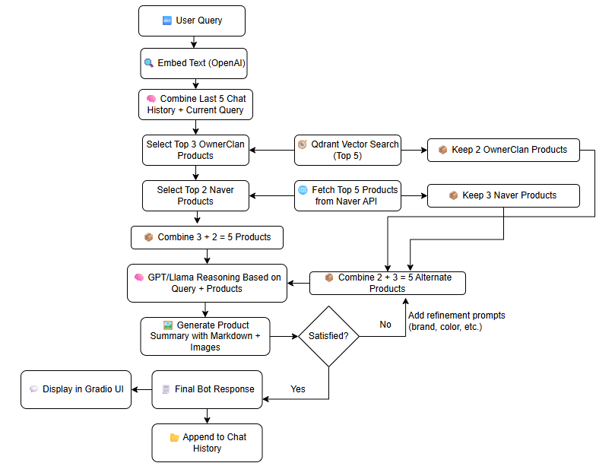
Chatbot Working Pipeline
5

Slide 7
Evaluation Metrics in Product Recommendation System
Metric | Description | Use Case | Goal
Precision@K | % of top-K results that are relevant. | Measures how accurate the top product picks are. | High precision = fewer irrelevant suggestions.
Recall@K | Fraction of relevant products that appear in the top-K recommendations. | Measures how completely relevant products are captured. | High recall = fewer missed good products.
NDCG@K | Ranking quality considering position weights | Ensures the most suitable products appear first in the list. | Good rank order = better UX.
MRR@K | Evaluates how quickly the first relevant item appears in the ranking. | Ideal for single-answer queries like FAQs or product lookups | Higher MRR = relevant results appear earlier, improving user satisfaction.
MAP | Average of precision values at ranks of all relevant items (overall score). Mean of average precision across queries | Summarizes precision across positions — helpful for comparing system performance. | Balanced overview of recommendation quality.
6

Slide 8
Live Demo
7

Slide 9
Thank You for Listening.
8

